Slide 1

Lab - Azure
ISEP – 03/2023
Part #1
V0.1

Slide 2

GET THE FUTURE YOU WANT

Slide 3
Contacts
1

Slide 4








Contacts
For more information please contact our Capgemini Team
Pierre NAVARRO
Mohand BELLACHE
Darren BOUTROS
pierre.navarro@capgemini.com
mohand-cherif.bellache@capgemini.com
darren.boutros@capgemini.com
Cloud & Data Architect
Cloud & Data Architect
Managing Solution Architect
Automotive, Oil & Gas
Utilities
Defence & Banque et finance

Slide 5
#Billing
2

Slide 6
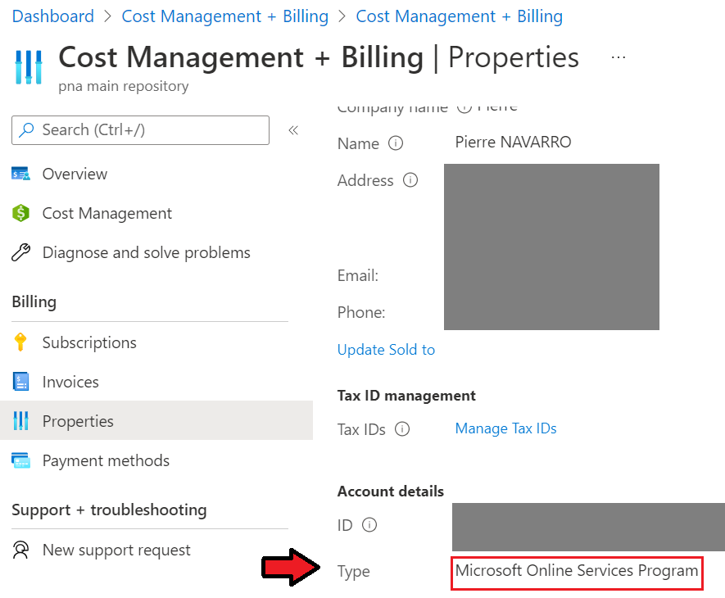
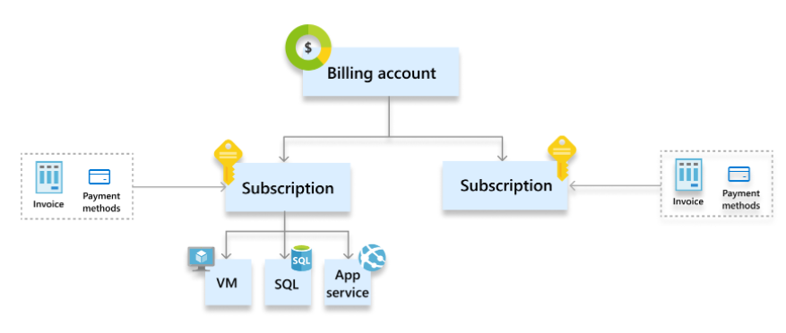
Microsoft Online Service program #accounts
Billing account: Represents an agreement that a customer accepts to use Azure. It contains one or more subscriptions.
Subscription: Represents a grouping of Azure resources. Invoice is generated at this scope. Other billing information such as payment methods and usage address is associated to this scope.
https://docs.microsoft.com/en-us/azure/cost-management-billing/manage/view-all-accounts#scopes-for-billing-accounts

Slide 7
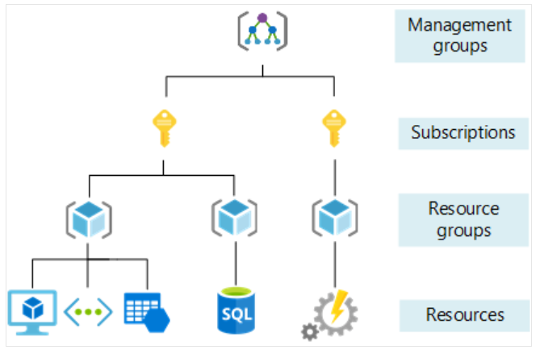
Azure hierarchy (#SCOPEs)
Management Groups: may represent an environment (Production, Staging etc..)
Subscription: may represent a project
Resource Group: may represent an application. All resources in a RG are deployed / Updated / Deleted at the same time.
https://docs.microsoft.com/en-us/azure/cloud-adoption-framework/ready/azure-best-practices/organize-subscriptions

Slide 8
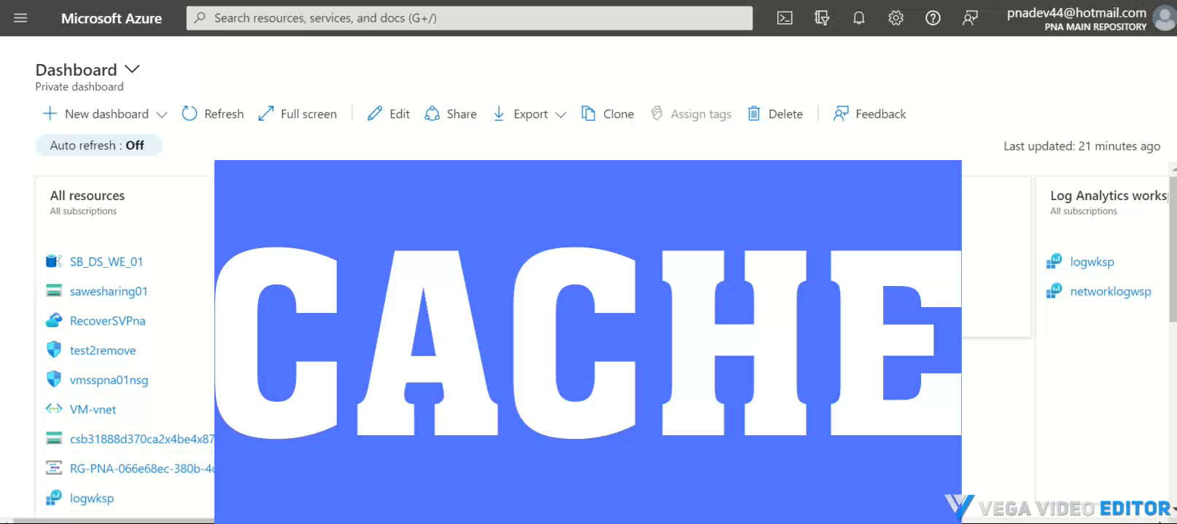
#secure your MS account with MFA

